Slide 1
Meeting Modern
Modeling Challenges
Jeremy Raw, P.E.
November 20, 2025
Email: jeremy@jeremyraw.com

Slide 2
Modern Modeling Challenges
Improving models continues to be a difficult process.
Human behavior is a messy mystery
  Especially when circumstances shift rapidly and dramatically (e.g. COVID)
Too much data, too hard to make sense of
Artificial intelligence
  Can give us a greater ability to mine data and our opinions about data
  Tells us less than ever about how our future planning actions might lead to future outcomes.
Yet all is not lost!

Slide 3
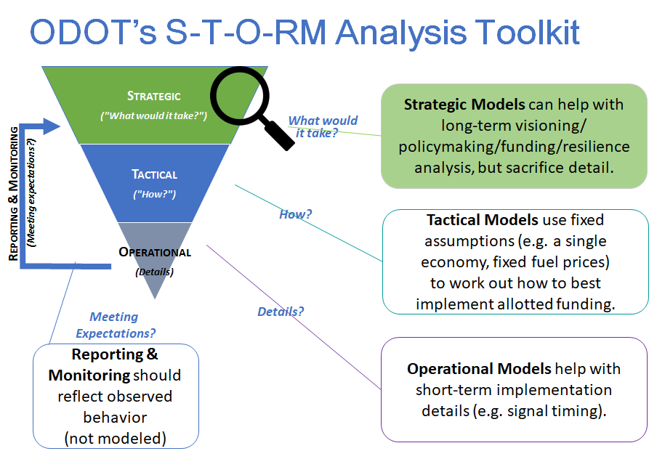
What We Use Models For (S-T-O-RM Diagram)
Source: Oregon DOT

Slide 4
How to Recognize a Good Model
Verification
  Does the model do what you think it does?
Validation
  Can it reproduce independent data (not used to estimate or calibrate)?
Acceptance
  Does it generate useful information relative to the decisions it will support?
https://www.cto.mil/sea/vva_rpg/

Slide 5
Evaluating the Usefulness of a Model
Understand the decisions the model will support
  What are the goals?
  What are the challenges to reaching those goals?
  How do we address the challenges?
Quantify the responses to those questions
Performance-Based Planning
http://www.fhwa.dot.gov/planning/performance_based_planning/pbpp_guidebook/pbppguidebook.pdf

Slide 6

Performance-Based Planning:
Definition
Evaluate measurable outcomes relative to a target
Then do things to get closer
Measurable – “What is it?”
Target – “What does it mean?”

Slide 7
Performance-Based Modeling (1)
The goal of a model is NOT to reproduce “reality” (whatever that is!)
The goal is to estimate performance measures under new conditions
Things that can go wrong:
  Excessive volume of output
  Excessive precision
  Sense of “immutable destiny”

Slide 8
Performance-Based Modeling (2)
How to get it right
  Model estimates comprehensible metrics
  Model transparently responds to changed inputs
  Model allows comparison of alternatives (“exploration”)
Notes:
Exploration is about

Slide 9
Getting Comfortable with Decisions
Who will be unhappy, and why?
Have we missed anything (inputs, responses, sensitivity)
Are the results believable?
Are the results explainable?
Do we understand the model’s limits?

Slide 10
Modeling Approaches: Correlation Models
Independent variables => Correlated outcomes
Relatively easy to build this kind of model
Presumes we know the important factors and that they are stable
Classic Four-Step Models are the classic example

Slide 11
Modeling Approaches: Explanatory Models
Activity- or Agent-Based Models, for example
Attempts to explain “why” we expect the outcomes (that’s good!)
Simulates the process that generates the metrics
Still vulnerable to misrepresenting the process
  Mode “choice” or mode “share”?

Slide 12
Modeling Approaches: Pattern Extraction
Machine Learning (ML) or (rebranded) Artificial Intelligence (AI)
Extract patterns and correlations that may not be obvious (ML)
Extrapolate from patterns and correlations to new conditions (AI)
Pitfalls:
  Resemblance to the known is what makes the results believable
  Risk of Hallucinations, “Deep Fakes”, and Sycophantic outputs (tells you what you want to hear): “If it looks real, it is real”
  Because it’s “intelligent” we can’t argue with it ☺

Slide 13
The Peril of “Big Models”
Expensive to maintain
Hard to understand
Difficult to explore novel conditions (especially “paradigm shifts”)
Good hiding places for unexpected assumptions and insensitivity

Slide 14
Exploratory Models
Clearly relate assumptions to outcomes
  Testing assumptions against the known
  NOT for predicting the unknown
  Keep things simple
Strategic Models : VisionEval
Exploring your existing model: TMIP-EMAT

Slide 15
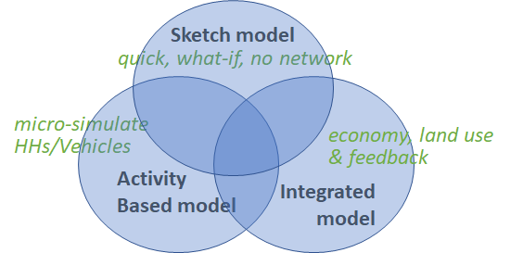
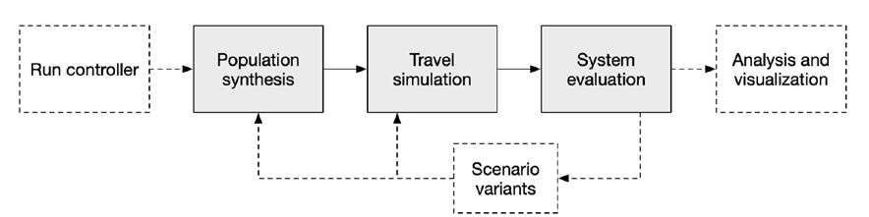
VisionEval Strategic Modeling System
VisionEval models occupy niche between...
… balancing rapid computation & accurate representation

Slide 16
VisionEval Performance Measures
Mobility
• Daily VMT per capita
• Annual walk trips per capita
• Daily Bike trips per capita
Economy
• Annual all vehicle delay per capit
• Daily household parking costs
• Household (HH) vehicle operating cost (fuel, taxes, parking)
• HH ownership costs (depreciation, vehicle maintenance, tires, finance charge, insurance, registration)
Land Use
• Residents living in mixed use areas
• Housing type (SF: MF)
Environmental
• GHG emissions per capita, per HH
• Commercial and Transit GHG/mile
Energy
• Fuel consumption per capita (gallons)
• Fuel efficiency (net miles per gallon)
• Annual external social costs per HH (total/% paid)
16

Slide 17

VisionEval Key Features
Rapid Scenario Evaluation
Scenario Planning
Strategy Development
“Understand the Problem”
rather than
“Implement the Solution”
https://visioneval.github.io

Slide 18
TMIP-EMAT
Define the uncertainty
and decision space
Scoping
Run model
across uncertainty /
decision dimensions
Model
Risk / Exploratory
analysis
Analyze
18
Notes:
Ability to rapidly explore scenarios, even in big models

Slide 19

TMIP-EMAT Key Features
Explore model capabilities
Explore scenarios
Test model sensitivity
https://tmip-emat.github.io

Slide 20
Conclusion: How to do Models “Right”
Understand your problem with simple metrics
Understand what your model does and doesn’t do
Carefully document why the model is believable
Think in terms of offering “backstops” and “ballparks” rather than a certain future (especially early in planning)

